Slide 1
FINAL PROJECT: PROGRESS “L” TRAIN IMPACT ON VEHICLE OWNERSHIP
Hendra Wijaya – A20529195
Notes:
• Hi! I'm Hendra, and today I'll be presenting my progress on the final project:
• the impact of the CTA "L" train on Chicago vehicle ownership,
• as part of the Online Social Network Analysis course.

Slide 2
Introduction About the project
Notes:
• I chose this topic because, as you can imagine, I use CTA to go to the university.
• And, also because...

Slide 3
of community areas have at least one "L" station. (Chicago Data Portal, 2022)
55%
Notes:
• Based on my initial study, the "L" train routes cover 55% of Chicago community areas.
• With half of the majority areas covered,
• and businesses are usually concentrated around train stations:
• I believe public transportation has a significant impact on vehicle ownership.

Slide 4
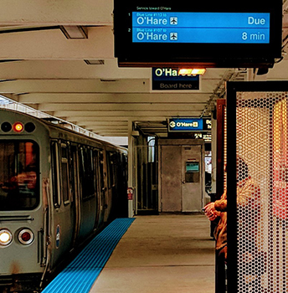
Background
Does access to "L" stations affect vehicle ownership?
Analyze the population with means of transportation.
Track changes in "L" stations.
Compare data between community areas with and without access to the station.
Notes:
• To prove this, the project will analyze the population with means of transportation to work or study.
• Then, compare changes in "L" train routes over the years,
• we want to see if a new train station or line extension covers a new community area.
• Finally, compare vehicle ownership between regions with and without access to at least one station.

Slide 5
Summary Project components
Notes:
• The project will reuse all components from Homework 4 and some new datasets.

Slide 6
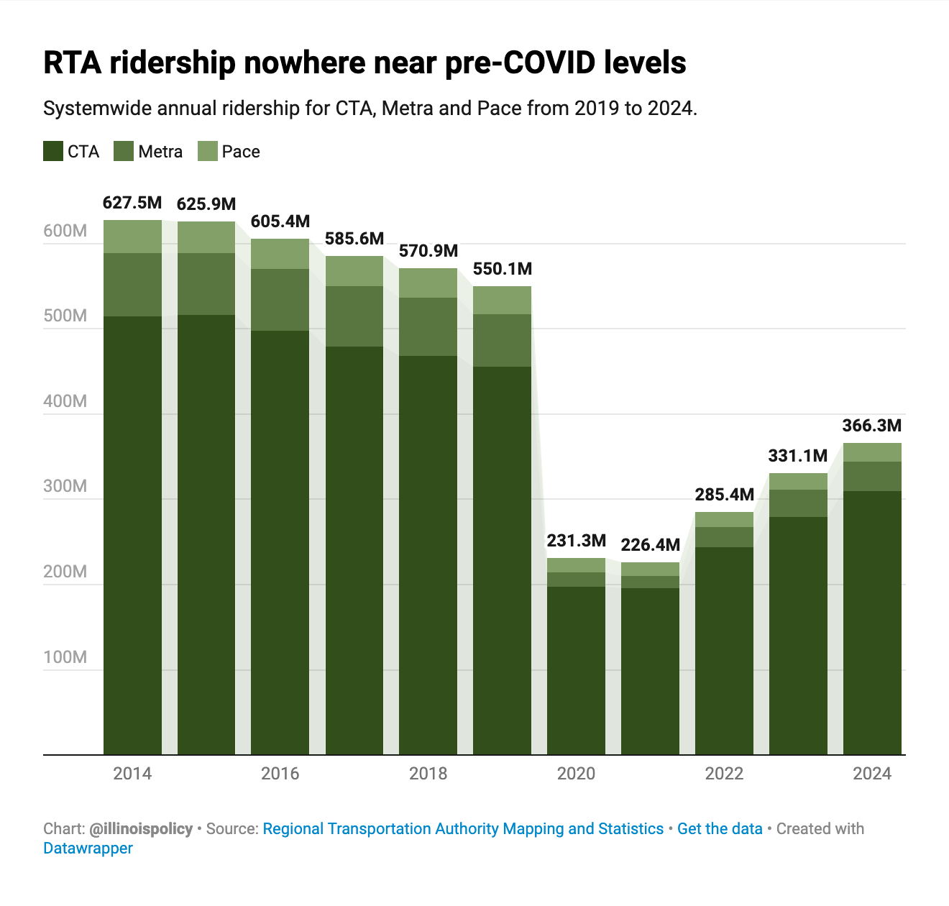
Notes:
• Before I start, it is important to note that,
• although CTA ridership is improving,
• it is still nowhere near pre-pandemic levels.
• This may affect the analysis results, but only from the year 2020 onward.

Slide 7
Reused components
Type | Previously | Addition
Datasets | Census.gov: Decennial 2010, Decennial 2020, ACS 2019–2023 Chicago Data Portal: Community area boundaries | Census.gov: Decennial 2000 Chicago Data Portal: Latest rail station locations
Tools | Fetching: census Processing: numpy, scipy Visualization: matplotlib, seaborn, networkx | Interactive: jupyterlab
Deliverables | PDF file Source code | PPT slides
Notes:
• The reused datasets from Homework 4 are the Census and the Chicago Data Portal, with a new addition of the Decennial 2000.
• The project will also reuse the same tools: Python packages to fetch, process and visualize the data.
• Finally, the deliverables will include a PDF report, source code and PowerPoint presentation.

Slide 8
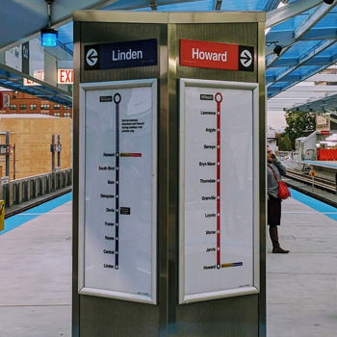
New components
Chicago-L.org Scanned image of rail route maps throughout the century.
Illinois Secretary of State (.gov) Yearly vehicle counts by county.
Notes:
• There are also new sources of datasets for this project:
• Chicago-L.org provides a historical map of "L" train routes, including station locations and line extensions.
• and the Illinois Secretary of State website for the total count of vehicles registered in Chicago.

Slide 9
Outline starting point of the project
Notes:
• This section shows the project outline.

Slide 10
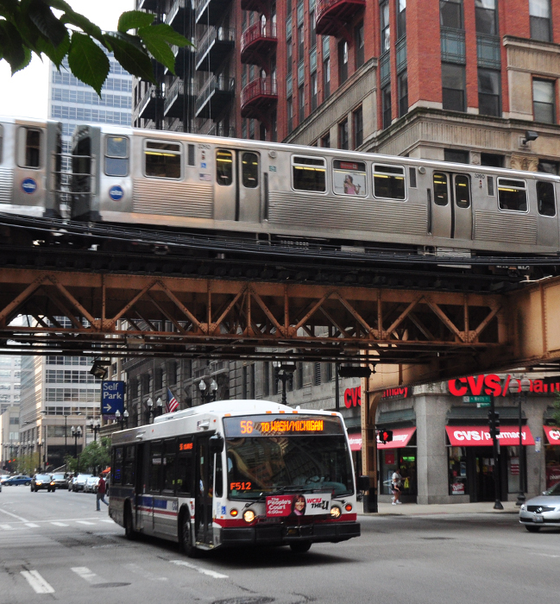
Find Census table Id
Type: Detailed
Type: Commute ability
B08301_001E
Subject: Commuting
Sequence: Total
Notes:
• First, find the correct table IDs related to commuting from the Census data.
• I need to repeat this step for all considered years.

Slide 11
Compare population to vehicle count
Notes:
• Then, compare the population with means of transportation to vehicle counts.
• For example, in 2023,
• we can see that the number of vehicles exceeds the population who drive alone,
• suggesting that a small portion of the population owns multiple vehicles.

Slide 12
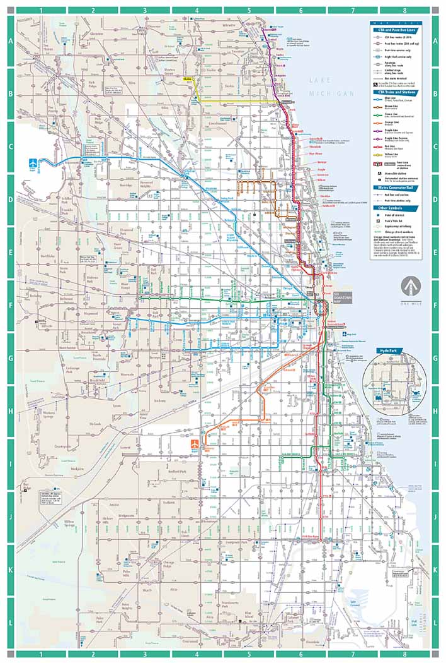
Track changes in routes
Draw community area boundaries on past train route maps.
Allocate stations to each area.
Repeat this process for the years 2000, 2010, 2020 and 2023.
Notes:
• Finally, track changes in "L" train routes over the years.
• I imagine this would be the most challenging part of the project.
• The latest routes are available as interactive maps online,
• but older routes are only available as static images.

Slide 13
“A developed country isn’t a place where the poor have cars. It’s where the rich use public transportation”
Gustavo Petro
Notes:
• As the President of Colombia once said,
• "A developed country isn't a place where the poor have cars. It's where the rich use public transportation."

Slide 14
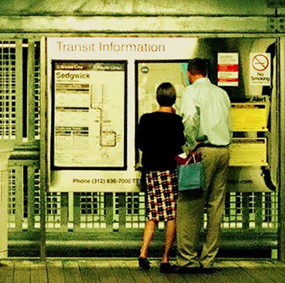
The end
Thank you!
Notes:
• With that, I conclude my presentation.
• Thank you for your attention.

